Slide 1
urBooks
November 4th, 2014
Reid Stancu
Nam Thach

Slide 2
Description
Application to Sell/Trade/Buy books
Able to use image recognition to post books
Able to search for books

Slide 3
Server Side

Slide 4
Server Side

Slide 5
Server Side

Slide 6
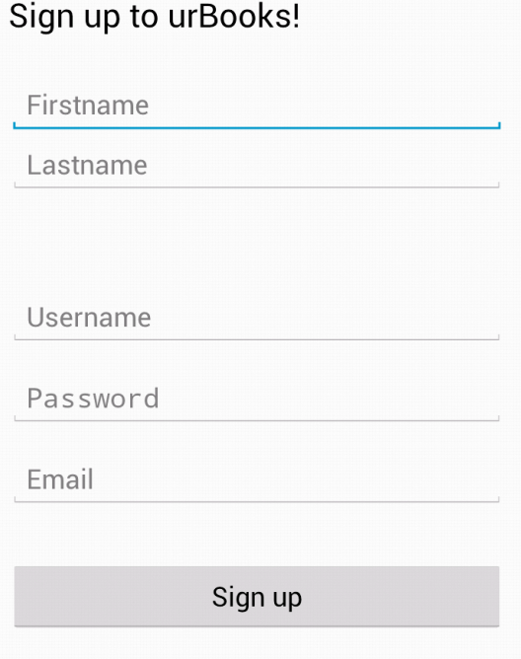
Client Side: Register Page

Slide 7
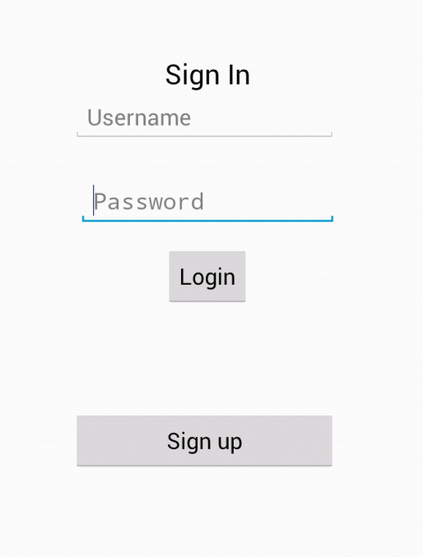
Client Side: Login Page

Slide 8
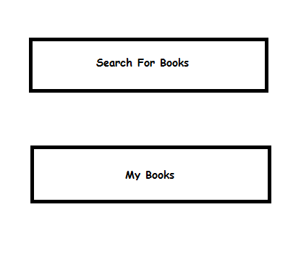
Client Side: Main page after login

Slide 9
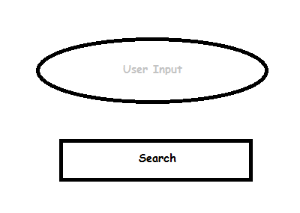
Client Side: Search Books

Slide 10
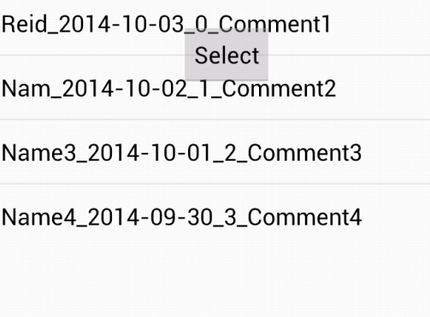
Client Side: Search Finds

Slide 11
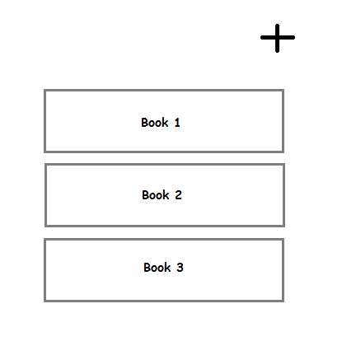
Client Side: My books

